Slide 1
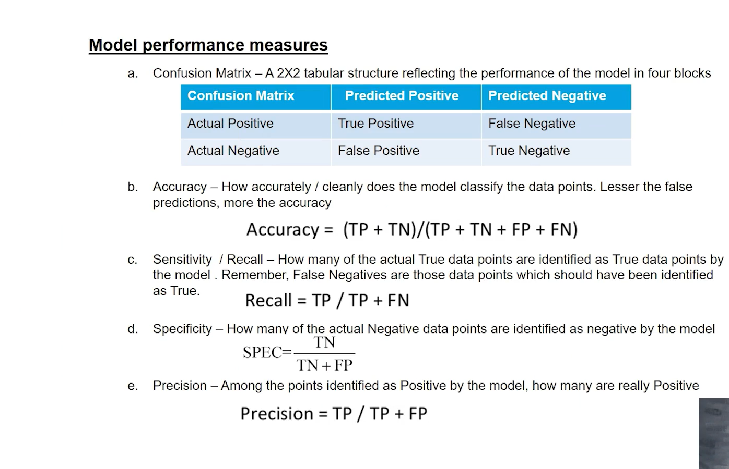

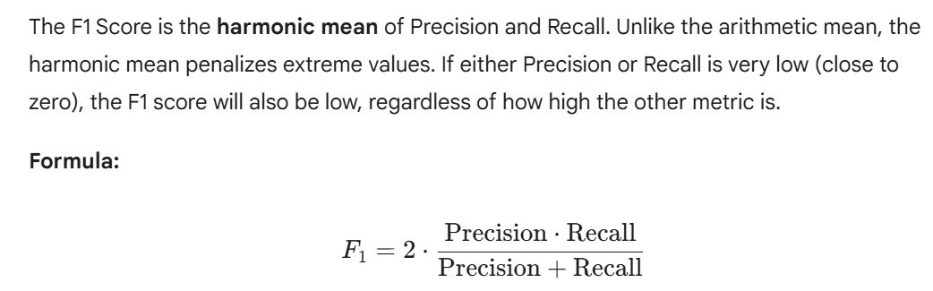

Slide 2
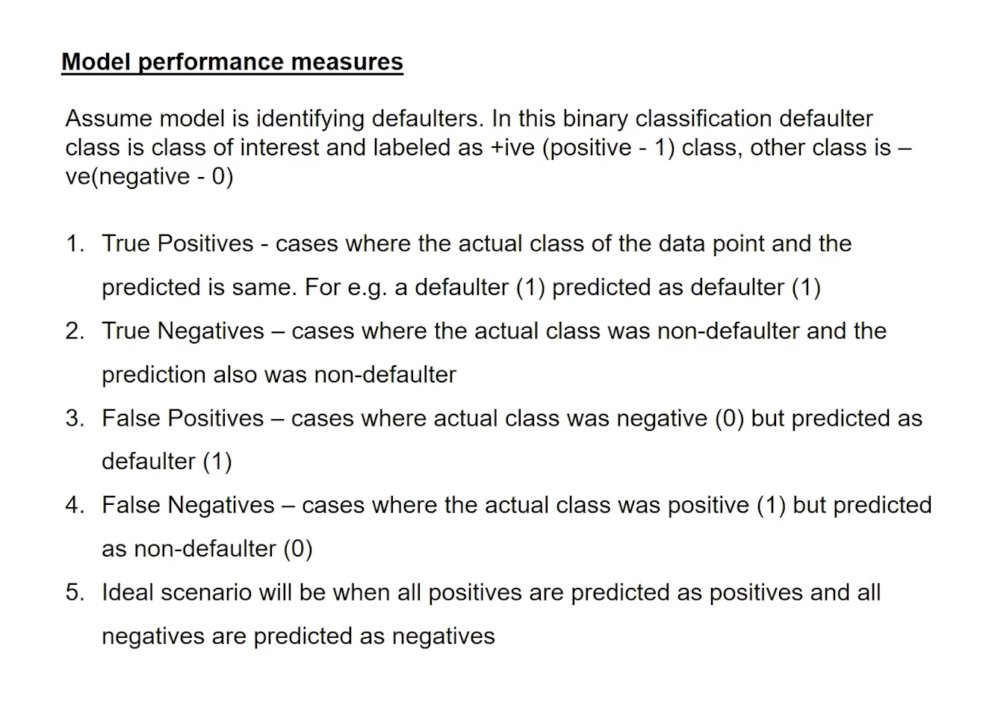

Slide 3
The Confusion Matrix: The Foundation
Every metric listed below is derived from the four outcomes of a Confusion Matrix:
True Positive (TP): Correctly predicted positive.
True Negative (TN): Correctly predicted negative.
False Positive (FP): Predicted positive, but actually negative (Type I Error).
False Negative (FN): Predicted negative, but actually positive (Type II Error).

Slide 4
ROC (Receiver Operating Characteristic) Curve and the AUC (Area Under the Curve) represent the gold standard for evaluating binary classifiers, particularly when the decision threshold is not fixed.
While metrics like Accuracy and F1-score evaluate a model at a single specific threshold (usually 0.5), ROC-AUC evaluates the model’s performance across all possible thresholds.
The ROC Curve
The ROC curve is created by plotting the TPR against the FPR at various threshold settings.
The Diagonal Line (Baseline): A diagonal line from $(0,0)$ to $(1,1)$ represents a model that is no better than random guessing (e.g., flipping a coin).
The "Perfect" Model: A model that reaches the top-left corner $(0,1)$ represents 100% sensitivity and 100% specificity.
The Convexity: The further the curve "bows" toward the top-left corner, the better the model's ability to distinguish between the two classes.

Slide 5
Model | Key Hyperparameters | Purpose / Impact
Logistic Regression | C | Inverse of regularization strength. Smaller values specify stronger regularization to prevent overfitting.
 | penalty | Specifies the norm used in the penalization (l1, l2, elasticnet).
 | solver | Algorithm for optimization (liblinear, lbfgs, saga). Affects convergence speed and multiclass support.
Support Vector Machine (SVM) | C | Regularization parameter. High C aims for zero training error (risk of overfitting); low C allows for a softer margin.
 | kernel | Determines the decision boundary shape (linear, poly, rbf, sigmoid).
 | gamma | Kernel coefficient for rbf. High gamma makes the decision boundary depend strictly on individual points (high variance).
K-Nearest Neighbors (KNN) | n_neighbors | Number of neighbors. Small $k$ leads to high complexity (overfitting); large $k$ leads to high bias.
 | weights | Weight function used in prediction (uniform vs. distance based on proximity).
Decision Trees | max_depth | Maximum depth of the tree. Deep trees capture noise (overfitting); shallow trees underfit.
 | min_samples_split | Minimum number of samples required to split an internal node. Controls tree growth.
 | criterion | The function to measure the quality of a split (gini vs. entropy).

